Slide 1



Deep Neural Network On FPGA Final Presentation
Students:
Amit Shtober
Alon Nemirovsky
Supervisors:
Ina Rivkin
Oz Shmueli
Winter 2020-2021

Slide 2
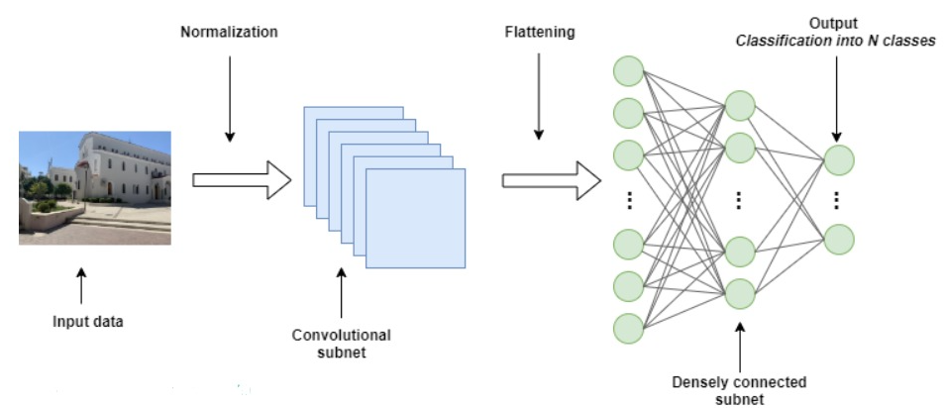
Deep Neural Network
Creation of Neural Network was inspired by the human brain and the way it functions
Works according to the algorithm and can predict a solution based on experience
The system has process layers that indicates on the depth of the Neural Network
This method is very popular and highly used today

Slide 3
Creating The Network
Full process of creating working neural network Includes:
Creating the model
Train it using CPU/GPU
Optimize the model
Inference which can be done on various machines such as host using GPU or dedicated Hardware
Create and manufacture the dedicated hardware which will run the Inference stage

Slide 4
Project Goals
Evaluate and validate the Xilinx Vitis-AI ecosystem :
1. Understanding Vitis-AI ecosystem
2. Running full flow from TensorFlow to the FPGA
Step #1 – Using trained model from Xilinx Zoo (resnet50)
Step #2 – Using untrained model from the Zoo (MNIST), Modify it and run the flow in order to fully understand the ecosystem ability
3. Evaluate and modify, when possible, each step in the process of the ecosystem
4. Creating a tutorial for running the flows step by step and indicate problems we have encountered in the process

Slide 5
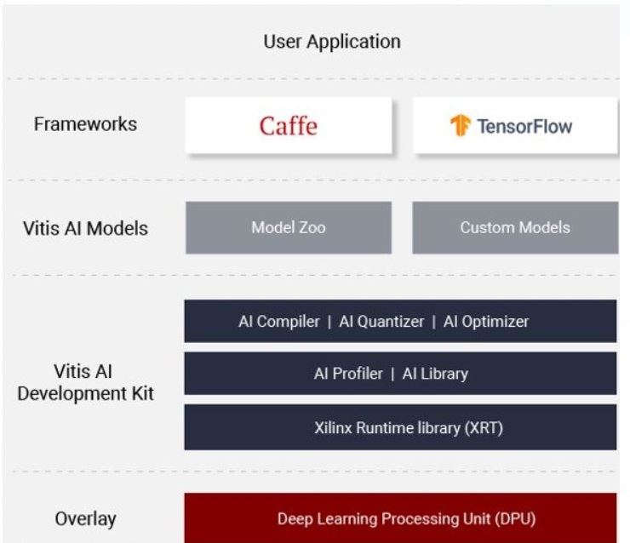
Vitis-AI Ecosystem
Xilinx offers a full ecosystem which helps deal with those problems. It includes:
Dedicated IP which called DPU
AI Zoo - Repository which includes optimized deep learning models. Great for quick start
Quantizer - Takes a floating-point model and performs pre-processing and then quantizes the weights/biases and activations to the given bit width
Compiler - Maps a network model into a highly optimized DPU instruction sequence

Slide 6
Full Flow - Block Diagram
Fetch trained
Model
Xilinx Zoo
V-AI Quantizer
Trained Model
Quantized Model
V-AI Compiler
Train using
Tensorflow
Host code
VART based code, send instructions to the DPU
Transfer to the Host Code
Kernel code
Compiled Model DPU instruction set
Untrained Model
ZCU104 evaluation board
ARM run the host code
(also: CPU kernel instructions)
DPU kernel instructions
DPUS run the DPU instructions
DPU Verilog Xilinx IP
Results
The DPU IP Uploaded as a bitfile to the FPGA during board booting, using the SD CARD slot

Slide 7
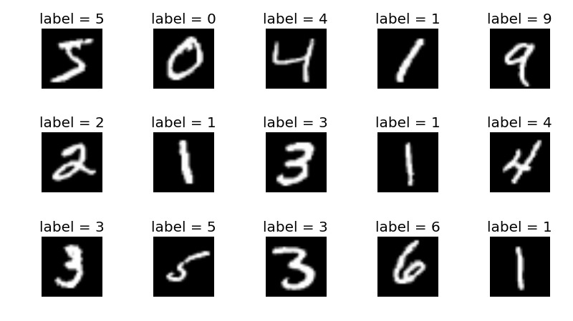
MNIST Classification Model
The MNIST handwritten digits dataset is a publicly available dataset that contains a total of 70k 8bit grayscale images each of which are 28pixels x 28pixels

Slide 8
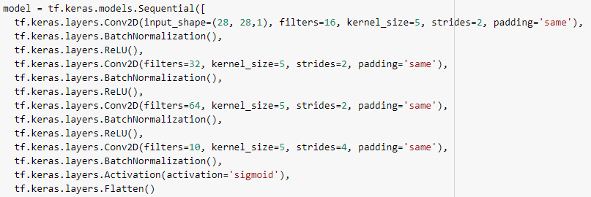
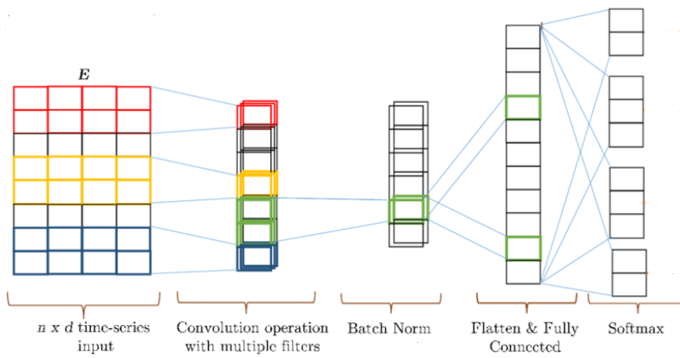
CNN

Slide 9
Setting Up The Environment – Insights And Problems
Initialize docker environment on the VM in order to use an exists image with Xilinx tools
Demands large storage
VirtualBox does not support FMA instructions, switched to VMware

Slide 10
Creating The Model – Insights And Problems
Create new model from scratch in TS and freeze it
Freezing the model in TS is complex, Demanded research in order to find a suitable way to do it

Slide 11
ZCU104 evaluation board
An integrated circuit designed to be configured by a designer using HDL
Great for parallel tasks (adders and multipliers)
USB
PL - FPGA
PS - ARM® Cortex™-A53 processor
UART
ETHERNET
SD CARD
ZCU104
evaluation
board
DDR4

Slide 12
Development Kit – Insights And Problems
Quantize and Compile the model using Xilinx tools
The model output files works only using TensorFlow 1.x
The ecosystem having trouble use fully connected layers, therefore we used our own convolution layers.
Reason: Xilinx tools transform the FC layers into Conv layers, Thus exceed the maximum input size.

Slide 13
Development Kit – Insights And Problems
Quantize and Compile the model using Xilinx tools
Dense-softmax layer failed in quantization stage. Used sigmoid layer as a workaround. Reason: The Quantizer is not compatible to work with this layer’s output.
The sigmoid layer couldn’t run on the DPU, only on the CPU

Slide 14
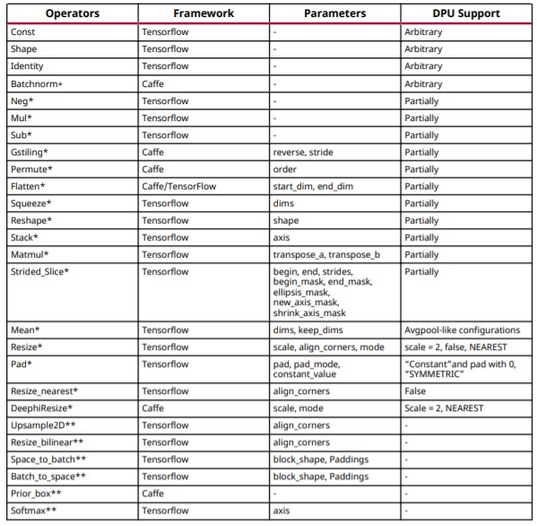
Insights and problems of the ecosystem
Interaction between the CPU and the DPU
Some layers can run on the CPU, some on the DPU. It depends on the Hardware capabilities!

Slide 15
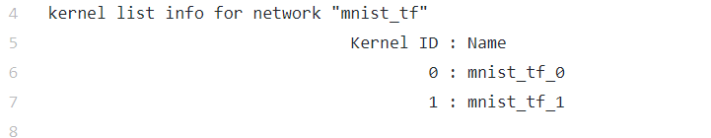
Insights and problems of the ecosystem
Interaction between the CPU and the DPU
The Vitis-AI compiler will figure out which layers can run on each processor
It will export two type of kernels:
Data flow: ...CPU->DDR->DPU->DDR...

Slide 16
Evaluations And Modifications
Optional modifications in the process
Number of calibration iterations in the quantization stage
Increasing the number of iteration and accordingly the number of the images
Built in quantization methods – method 0/1
Number of threads
Change the weight/activation bit width from 8 bit to 16 bit

Slide 17
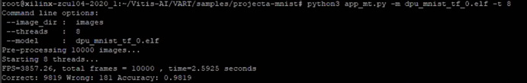
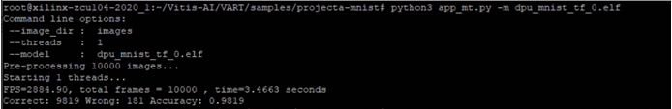
Optimal Running Time Modification
Number of threads
Change the number of threads which run the inference stage on the board. We have changed it in order to optimize the running time
Improve of 16.5%! (Running Time)

Slide 18
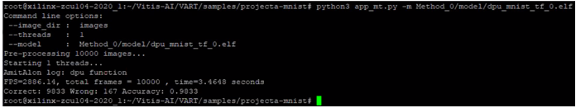
Optimal Accuracy Modification
Quantization method
There are two methods of quantization, big range of the quantization values and smaller one. By default, the board choose the smaller one. We chose the method that have the bigger range of quantization values
Improve of 0.14%! (Accuracy)

Slide 19
Evaluations And Modifications – Insights And Problems
We faced many Issues in the modification process:
Changing from 8 bit width to 16 bit width is not possible. The board can work with width of only 8 bit
We found that the relevant modification is possible only in the quantization stage.
Accuracy can be improved in substantial rate on method 0 quantization
Running time can be improved in substantial rate on the right quantity of threads due to its parallelism

Slide 20
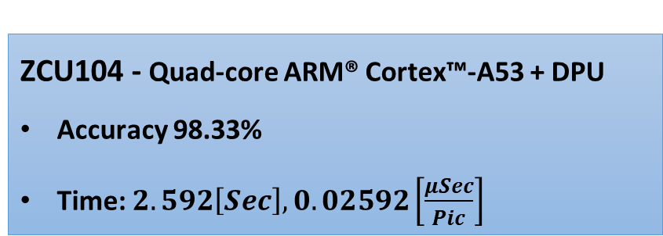
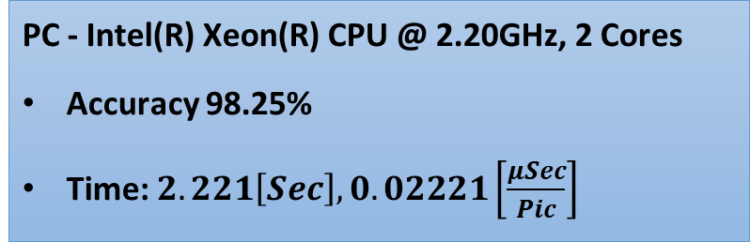
Performance
PC - Intel(R) Xeon(R) CPU @ 2.20GHz, 2 Cores
Accuracy 98.25%
Time: $2.221\left[Sec\right],0.02221\left[\frac{μSec}{Pic}\right]$
ZCU104 - Quad-core ARM®️ Cortex™️-A53 + DPU
Accuracy 98.33%
Time: $2.592\left[Sec\right],0.02592\left[\frac{μSec}{Pic}\right]$
ZCU 104 can achieve higher accuracy! However, it’s slower compared to inference on a regular PC
On the board we can make modifications in many points between the model and the inference, for example the quantization stage. Less trivial to do on basic Collab

Slide 21
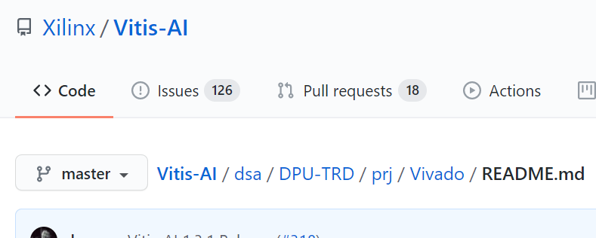
Compile and deploy DPU’s RTL (POC)
POC in order to see the complexity of compiling and deploying the DPU’s RTL into the ZCU-104 board

Slide 22
Compile And Deploy DPU’s RTL (POC) – Insights And Problems
The only available guide that’s exists is for a different board (ZCU-102)
Requires a lot of adjustments and changes In each step in the process:
RTL - Compiling
Configuring and build the Peta-Linux project
Creating the boot image
Configure the DPU itself
It is better to be performed on ZCU-102 board
In any Case - it’s a long and complex process. Even after Success compiling, encountered problems of compatibility with the board

Slide 23
Conclusions
In some cases, the board can achieve better accuracy than normal computer in the inference stage due to his dedicated hardware
Xilinx gives AI ability, even to unexperienced people (although it could be limited)
Creating your own Custom model is very complex. Many adjustments have to be done in order to successfully run it on the board
There is a lack of updated information on Xilinx ecosystem. Therefore, it’s hard to solve problems that arise during the process

Slide 24
Future Work
Test and validate the ecosystem on different framework (Caffe, PyTorch)
Compile and deploy DPU’s RTL (POC)
Combine the board with real life applications

